Slide 1



Capstone Project
Agentic
AI
Contributors
Nishchay Tiwari tiwarinish92@gmail.com
Sivaswamy Akilesh akilesh10a@gmail.com
Jaydeep Kumar kumarjaydeep09@gmail.com
Shivanshu Soni
Lalith Kumar
Arindam Nag arindamng@gmail.com
Shivaj More
Conversational Product Discovery, Multilingual Retrieval & Transparent Billing - Driven by an Agentic, Explainable AI stack.

Slide 2

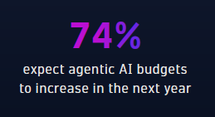

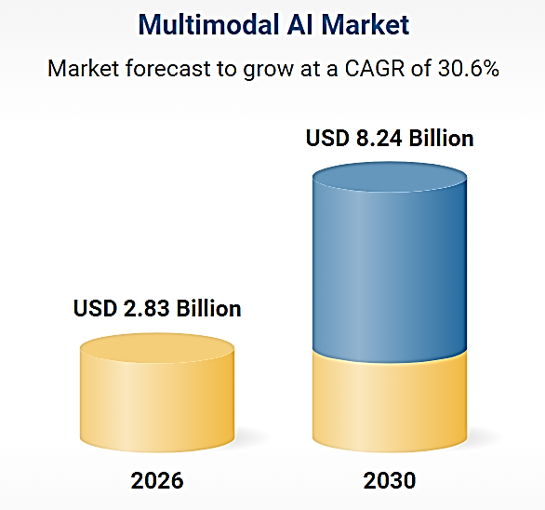
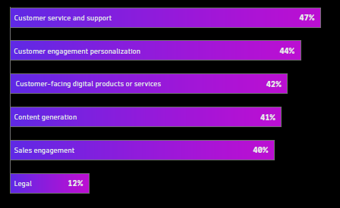
Dynatrace report of agentic-ai-in-2026
The world is moving to make strategic decisions, enabling them to advance and scale trustworthy autonomous operations using real-time observability.

Slide 3




Problem Statement
Current commerce assistants operate in silos—treating text, images, and data as isolated inputs. This lack of "multimodal reasoning" leads to inaccurate search results and "black-box" billing that erodes user trust.

Slide 4

Solution Plan
The Agentic Multimodal Commerce Platform is a research and engineering initiative that lets shoppers find products and complete checkout-style flows using natural language (including multiple languages) and product images, not just keyword search.
Today’s commerce assistants often treat text and images in isolation, treat OCR as plain text without product semantics, and automate billing without enough transparency. This project builds a single conversational system that reasons across modalities, adapts its workflow dynamically, and explains what it matched and why—so it can be taken seriously in real retail and e-commerce settings.

Slide 5



This project is built on an agentic architecture featuring dynamic routing that is explainable, multilingual, and safe by design—aligned with production-grade AI deployment in e-commerce.
Issues We Tried To Solve
By Implementing
Discovery is text-only or image-only, rarely both in one flow
Image based Product recommendation, Customer behavioral patterns
Weak multilingual support
Automated Billing lifecycle
Brittle, linear AI pipelines
Unified chat + image upload with orchestrated multimodal retrieval
CNN models used to recommend similar items based on users text & Image queries
Translator Agent with multilingual support
Billing & Explanation Agents with RAG-backed rationale
Explicit nodes, edges, conditions, retries, and fall backs

Slide 6

Tech Stacks & Application
Streamlit | Conversational UI: chat, image upload, streaming responses, confirmation controls
LangGraph runtime | LangGraph States used as central memory for agentic workflows to direct different Agent actions (Billing, Cancellation, Refund Support)
Agent layer | Pluggable agents: conversation manager, guardrails, intent, retrieval, vision, translation, billing, explanation
FalkorDB | Vector store for multimodal RAG (text, image), Automated Billing Ingestion & Status
Config / prompts | Model endpoints, thresholds, safety rules, and prompt templates
Tests & eval | Similarity scores (Cosine), Agent Task Success Ratio
LLMs | OpenAI(gpt-4)
Text embeddings | Sentence-Transformers, BGE, Instructor
Image embeddings | ReNet50/TorchVision

Slide 7

Agentic orchestration
A conversation manager coordinates specialized agents; workflows are not a single fixed chain
LangGraph Control flow
Nodes (agents/steps), edges (transitions), and conditions (which path to take) are first-class; supports loops for retry and user confirmation
Multimodal RAG
FalkorDB stores text, image, OCR, and multilingual vectors for retrieval-augmented grounding.
Confidence-aware automation
High / medium / low confidence gates drive billing, user confirmation, or fallback—not blind automation.
Guardrails
Input validation, policy constraints, and thresholds before irreversible actions (e.g. billing).
Open-source stack
Python, Streamlit, LangGraph, open LLMs and embedding models, enabling reproducibility and cost control.
Logical
Components

Slide 8










Agents & Their Responsibilities
Conversation Manager | Session state, intent (text vs image path), LangGraph route selection
Guardrails | Validate inputs; enforce product/policy rules; confidence thresholds for automation
Intent classifier | Distinguish text query vs image scan and downstream branches
Text retrieval | Multilingual query embedding; semantic search in FalkorDB; ranked candidates
Vision search | Image embedding; similarity search in FalkorDB
Translation | Normalize text to a canonical language for search and responses
Billing & validation | Price, tax, discount; invoice generation
Explanation | Use RAG context to justify decisions to the user

Slide 9


Use case
Retail & e-commerce teams prototyping conversational and multimodal search without vendor lock-in.
Global or multilingual catalogs where queries and product copy mix languages.
Operations that need auditable steps: why a SKU was chosen, what confidence was, and what the user confirmed.
Research and coursework (IITR) demonstrating modern RAG, agents, and graph-based orchestration on realistic commerce scenarios.
USP
Faster checkout
Reduced manual intervention
Multilingual global support
Enterprise-grade trust and safety

Slide 10





Retry & fall-back
Product
Recommendation
Input
Text/Image
Resnet50
Falkor DB
Chatbot
Prompt
Intent Classifier
Confidence Evaluation
LLM
Routing
Cancellation / Billing / Translator / Order / Refund Agents

Slide 11
Metrics

